Slide 1
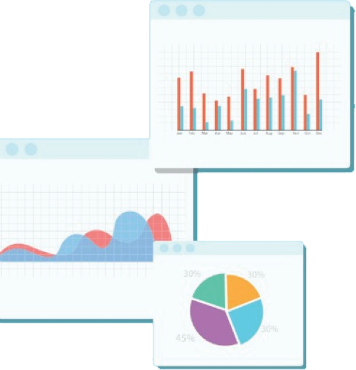

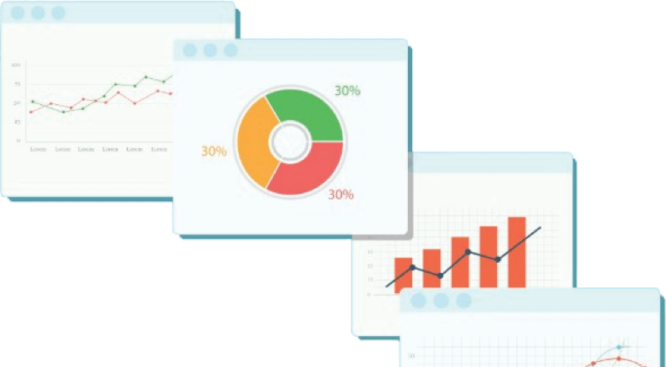
Welcome to Week 1
Lecture 1!
Data Science in Python &
Machine Learning

Slide 2
Agenda
Bookmarks to Save
Stack Schedule
This Week’s Assignments
20 Minute Rule
What is Data Science?
Python for Data Science
Object Oriented Programming
Practice in Breakout Groups

Slide 3
Important Links to Bookmark
Discord Channel: 01-24-Cohort-James
Learning Platform (https://login.codingdojo.com/
Daily Stack Schedule (https://bit.ly/32k7fwU)
Can always find in header of our discord channel.
Your Feedback Document
Sent out via email last week.

Slide 4




Program Schedule
12-Week Program
16-Week Program
Weeks 1 - 4
Data Science
Fundamentals
Weeks 5 - 8
Machine Learning
Weeks 9 - 12
Advanced Machine Learning
Weeks 13 - 16
Data Enrichment
Did you sign up for the 12-week program but want to change to the 16-week program?
No problem! Just contact Robbie Hannan rhannan@codingdojo.com and let him know you’d like to change programs.
Can do so up until the end of week 12

Slide 5
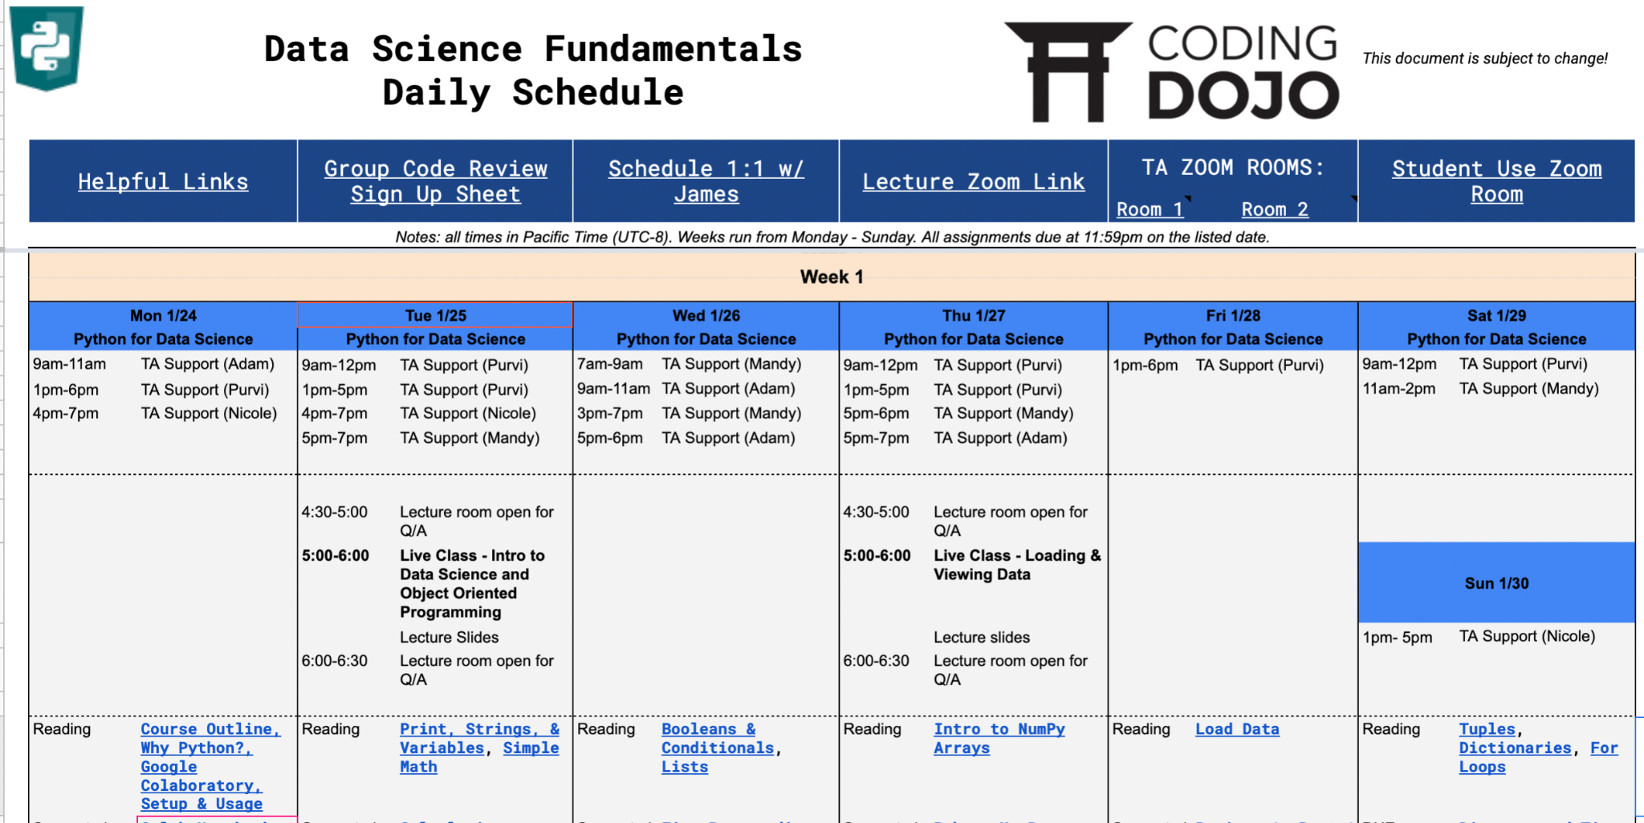
Our Daily Stack Schedule https://bit.ly/32k7fwU

Slide 6
Our Daily Stack Schedule https://bit.ly/32k7fwU
Important Sheet Links
ZOOM ROOMS

Slide 7
Live Classes
Note: We are currently on PST (UTC-8)
Lectures
Tuesdays & Thursdays
5 - 6 pm Pacific Time
Office Hours
30 min before and 30 min after live class --in the class zoom room!
Group Code Reviews
Mondays or Wednesdays
30-minute group sessions.
Optional, but strongly recommended.
Code Review Sign up sheet is inside our Stack schedule google sheet

Slide 8
Communication - Discord
Our main form of communication between your instructor, TAs & your classmates
You should have already joined!
Our channel: “🏫01-24-cohort-james”
If you have questions or concerns about the curriculum, program, or policies, please contact me (your instructor) and I will assist you or find someone who can!

Slide 9
Weekly Assignments:
Due Sunday 11:59pm PST
We check assignments with ‘(Core)’ next to the title of the assignment at the start of each new week.
For this week:
Bakery Numpy Exercise (Core)
Project 1 - Part 1 (Core)
Distance and Time (Core)

Slide 10

20 Minute Rule - When you begin to struggle:
Try to rely on yourself first. Spend 20 minutes trying so solve a problem on your own. Utilize your wits, notes, internet resources, etc as your primary resource.
After 20 minutes, ask at least 2 of your cohort mates for help---Post your questions to everyone on the Discord channel!!
Ask a TA or instructor.
While waiting for assistance, move on to something else to keep moving forward!
The key is to strike the perfect balance between taking it upon yourself to develop strength through struggle and knowing when to get help for the sake of efficiency.

Slide 11
Stack Progression
The minimum required to proceed to your next Coding Dojo course:
80% Lecture Attendance
Miss no more than 1 Live Class
90% Core Assignment Submission
Missing no more than 1 assignment
Passing Score on Belt Exam

Slide 12
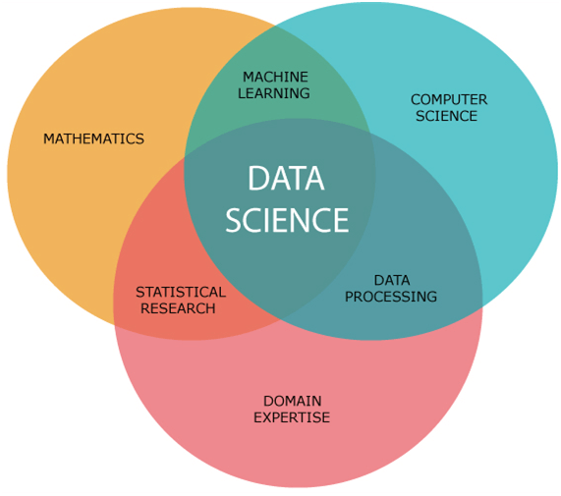
What is Data Science?
“Data science is an interdisciplinary field that uses scientific methods, processes, algorithms and systems to extract knowledge and insights from noisy, structured and unstructured data and apply knowledge and actionable insights from data across a broad range of application domains….”
Wikipedia’s Definition of Data Science
Image thanks to Serap Baysal

Slide 13
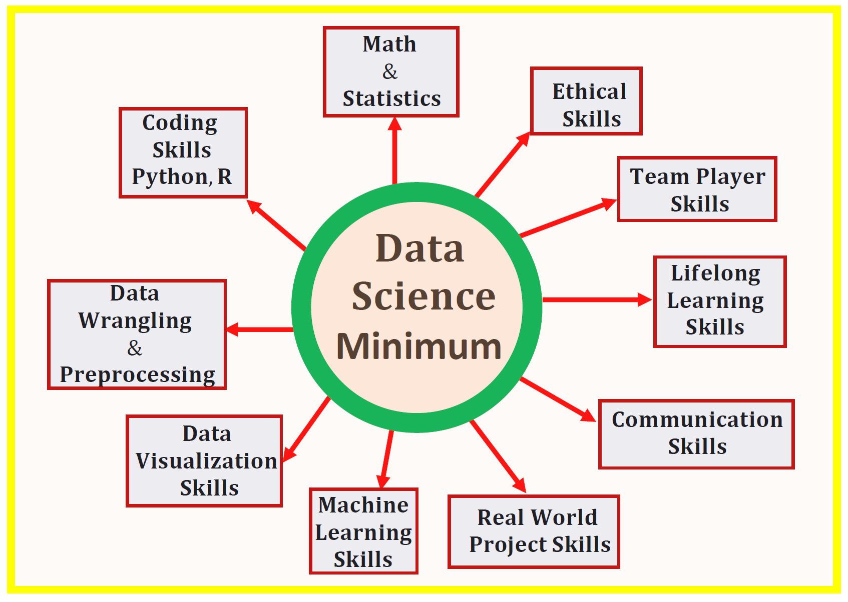
What do I need to learn?
Image thanks to Benjamin Obi Tayo, Ph.D

Slide 14
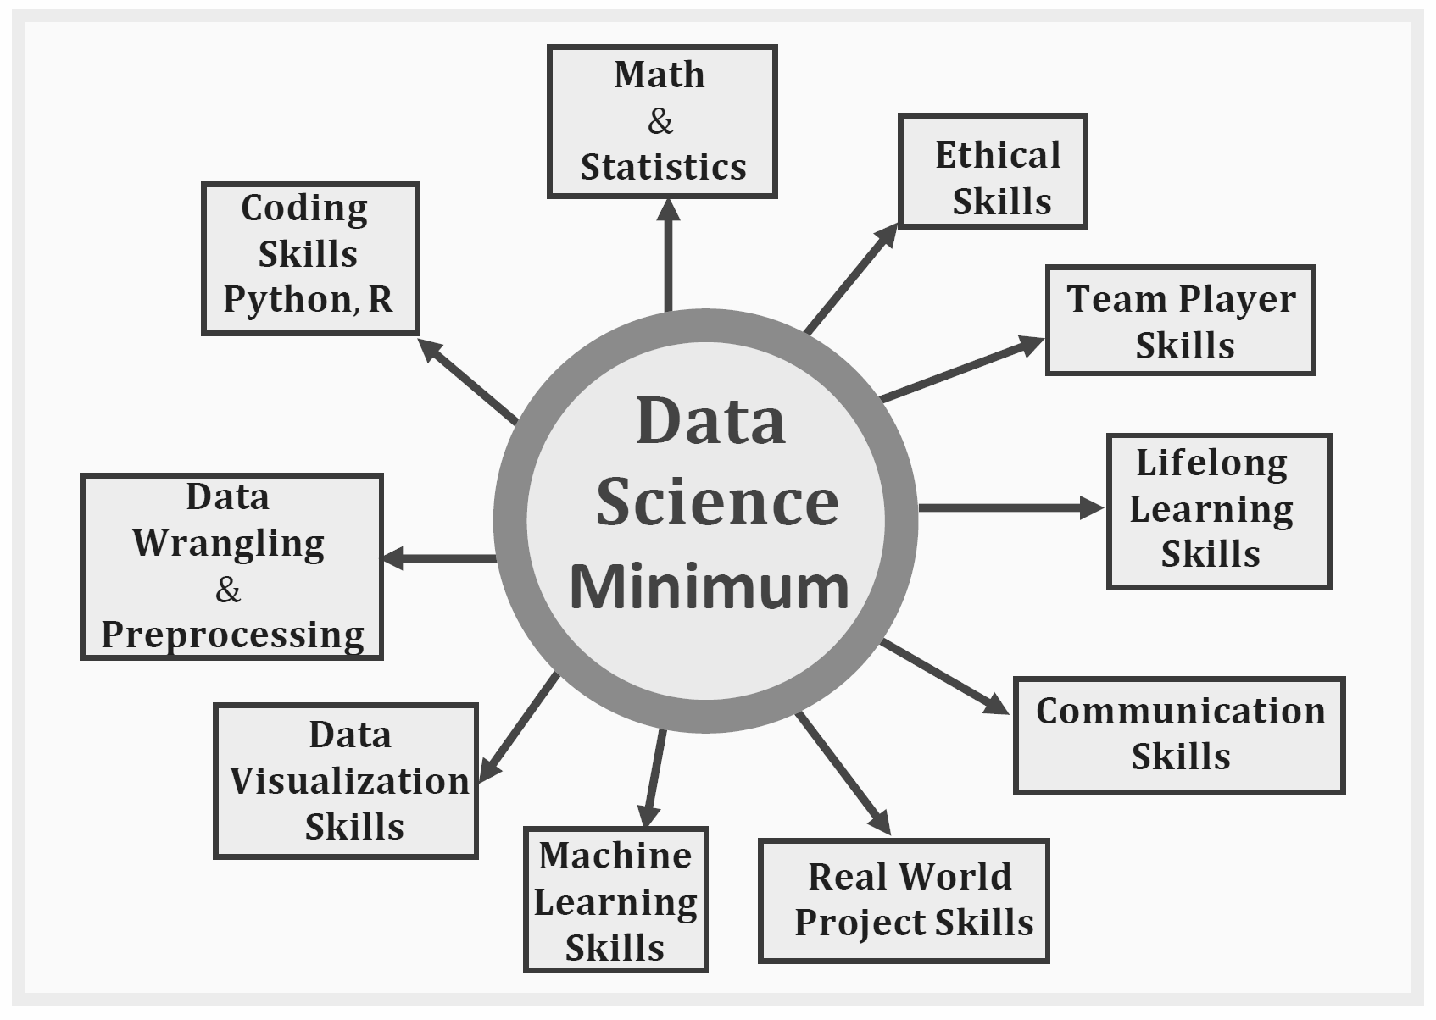
Stack 1 Foci:
Coding
Data Wrangling
Data Visualization

Slide 15
Week 1:
Python for Data Science
OOP: Object Oriented Programming:
Everything in Python is an Object!

Slide 16
Python Vocabulary
Object-Oriented-Programming:
Every variable is an instance of a blueprint class.
Before we get too Class-y
Let’s review some basic python vocabulary in our Colab Notebook!

Slide 17
Python Classes
Classes are blueprints for different types of objects.
Classes: type of object
Ex. string, list, tuple
Objects: specific example of classes
Ex. (‘hello world’, [1,2,3], (‘hello’, ‘world’))

Slide 18
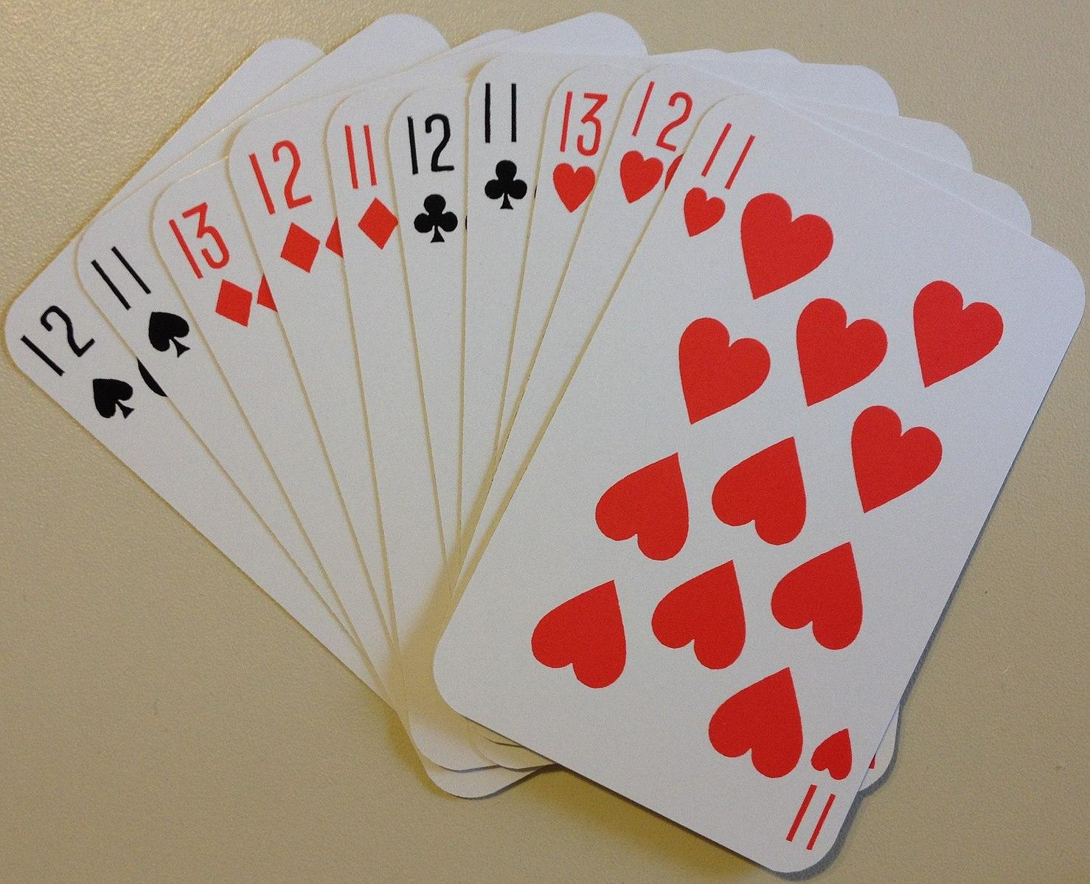
Example: PlayingCards
What attributes does a playing card have?
Value (2, 3, …9,10,J,Q,K)
Suit (hearts/spades/clubs/diamonds)
Color: determined by suit.
When we are playing a card game, we usually hide our cards’ value and suit.
We flip them over when we want to see their value and suit.
Countakeshi. (2017). English: Extra cards for playing the six-handed version of the Euchre variant, 500. Own work. https://commons.wikimedia.org/wiki/File:Six-handed_500_playing_cards.jpg

Slide 19
How Much Do I Need to Know About Classes?
Enough to understand how to use them.
You do NOT need to be able to write your own classes as a Data Scientist!
Examples:
Numpy Arrays.
Pandas DataFrames

Slide 20
Take it to Colab
When you open a Colab notebook from this course:
Open ‘File’ menu
Save a Copy In Drive
Change it, play with it, break it, fix it, make it your own.

Slide 21
Please Click Here
To proceed to the Notebook
In your breakout group:
Choose a Leader to read all text aloud and make sure the group remembers the directions.
Choose a Driver to share their screen.
The rest are Navigators, checking the Learn platform and Google for answers as needed.
Everyone code along to produce a completed notebook.

Slide 22
Notebooks from Today
01.24.22 Week 1, Lecture 1 - Python & Colab.ipynb
01.24.22 Week1, Lecture 1 - OOP Activity

